Slide 1
Essential Ingredients
for Cooking Up
Power Platform
Solutions

Slide 2
Who is it for and when to use it?
The list is a mix of tools that can be useful for:
Business analysts,
Functional and technical consultants,
Developers,
Architects,
Project managers,
Power Apps designers and creators,
Anyone interested in Power Platform.
Use it as a checklist when:
You’re new to Power Platform and you might not know all the tools.
You’re moving to a new job/contract and need to download and install all the handy tools.
You want to upskill yourself or train someone else and you don’t have a list like this yet.

Slide 3
Wireframing and proof of concept tools

Slide 4
Popular tools
Design tools allow you to create wireframes and prototypes for your Power Platform solutions. Opt-in for the tools offer intuitive interfaces, drag-and-drop functionality, and a range of design elements to help you visualize your ideas and validate your concepts before diving into development.
Name | Description | Link
Sketch | Sketch is a vector graphics editor for macOS that is used mainly for designing user interfaces and web graphics. It offers a wide range of tools and plugins to help designers create responsive and interactive designs. | https://www.sketch.com
Figma | Figma is a cloud-based design tool that enables real-time collaboration among designers. It allows multiple users to work on a design simultaneously, making it easier for teams to collaborate and iterate on designs together. | https://www.figma.com
Mural | Mural is a digital workspace for visual collaboration. It enables teams to brainstorm, organise ideas, and collaborate visually in real time. It offers various templates and tools to facilitate remote collaboration and creative problem-solving. | https://www.mural.co
Klaxoon​ | Klaxoon is a platform designed for team collaboration, meetings, and brainstorming sessions. It provides a range of interactive tools like quizzes, surveys, and brainstorming boards to engage participants and enhance productivity during meetings. | https://klaxoon.com
Miro​ | Miro is an online collaborative whiteboarding platform that enables teams to visualize ideas, brainstorm, and collaborate in real-time. It offers a variety of templates, sticky notes, and drawing tools to facilitate remote teamwork and creative thinking. | https://miro.com
Balsamiq | Balsamiq allows to quickly and easily create wireframes and mockups of an app's user interface. It helps to visualise ideas and gather feedback early in the development process. | https://balsamiq.com/

Slide 5
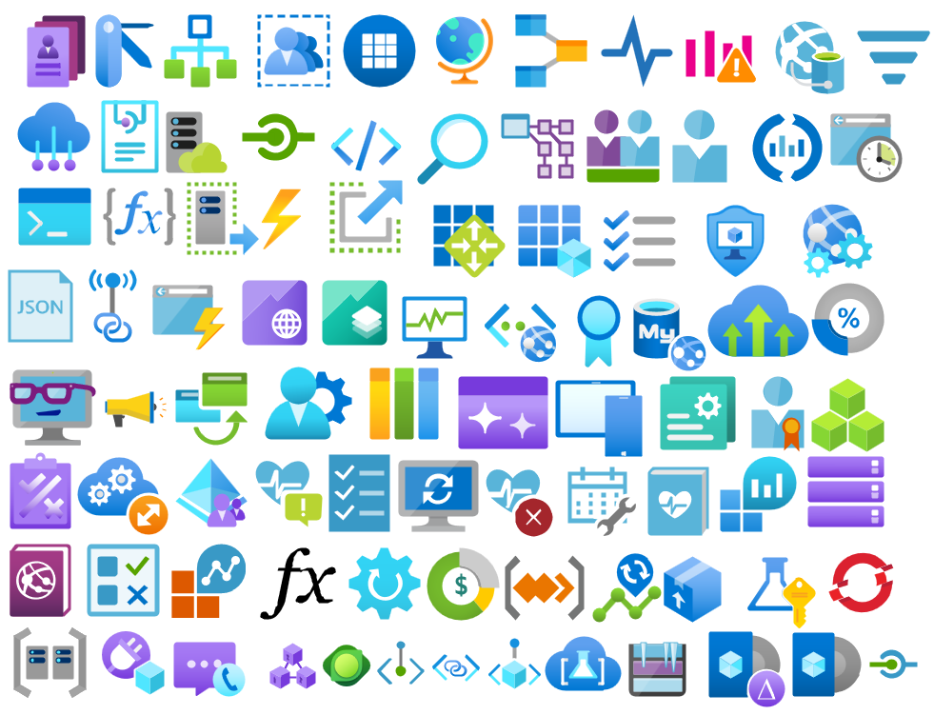
Visio
Visio is a powerful diagramming and visualization tool from Microsoft that can be invaluable when designing, planning, and documenting your Power Platform solutions. It offers a wide range of templates, shapes, and tools to create detailed diagrams, flowcharts, and schematics that can help you visualize the architecture, data flow, and processes of your Power Platform applications.
Use if for architecture design, data flow analysis, process mapping and to support documentation creation.
To support Power Platform diagram creation, install pre-build stencils for Visio: https://github.com/sandroasp/Microsoft-Integration-and-Azure-Stencils-Pack-for-Visio
Use XrmToolBox “Flow to Visio” to document your Power Automate Flows in Visio format.
Power Platform Visio stencils

Slide 6
Requirements and everyday tasks management

Slide 7
Azure DevOps
Azure DevOps is a comprehensive suite of development tools that includes source code management with Git repositories, continuous integration/continuous deployment (CI/CD) pipeline automation, and agile project management capabilities.
It integrates seamlessly with Power Platform, allowing to automate build and deployment processes and manage all projects more efficiently.
It also integrates with Office, which allows e.g. uploading user stories from Excel.
Azure DevOps Boards are used to manage user stories, features, epics and also for bug management.
Create tasks with estimates, track the team’s capacity and monitor progress.
Use the Wiki feature to create the design and build documentation with links to appropriate user stories.
For guidance and support on how to best use Azure DevOps, refer Dani’s Kahil resources:
Azure DevOps Boards articles series:
https://danikahil.com/2021/06/azure-devops-boards-for-dynamics-365-or-the-power-platform-structuring-requirements.html
https://danikahil.com/2021/07/azure-devops-boards-for-dynamics-365-or-the-power-platform-capturing-requirements.html
https://danikahil.com/2021/09/azure-devops-boards-for-dynamics-365-or-the-power-platform-requirements-life-cycle.html
Azure DevOps Boards YouTube playlist:
https://www.youtube.com/watch?v=hX9jabZBxm0&list=PLmktMFUmkclX4poZpdzbKoEje2zz4EPlg
Azure Devops Office Integration
https://visualstudio.microsoft.com/downloads/#other-family

Slide 8
Jira
Jira is an alternative to Azure DevOps.
It is used as a software development tool for agile teams to plan, track, and release world-class software.
Power Automate offers Jira connectors, which allows to automate development management. Use cases include e.g. posting a message to Teams when an issue is created in Jira, using Forms to send a response or creating tasks and other notifications.
Additionally, it also integrates with other tools to allow e.g., embedding Power Apps in Jira by copy-pasting the app’s URL.
Jira is Atlassian’s software, therefore it also easily integrates with Confluence. Both applications complement each other - use Confluence to collect thoughts, plans and knowledge while tracking issues in Jira.
Useful links:
https://www.atlassian.com/software/jira
https://confluence.atlassian.com/doc/integrating-jira-and-confluence-2825.html
https://www.youtube.com/watch?v=uhM_v2I6lWg

Slide 9
Confluence vs Notion
Confluence and Notion were designed to help teams organise knowledge and collaborate, and share similar features.
Both tools allow for building a knowledge base, sharing internal documentation, creating employee onboarding checklists, and more.
However, despite the high-level similarities, there are also several fundamental differences between them.
Confluence
Team workspace used for knowledge sharing and collaboration.
It is a mature and reliable solution launched in 2004 - it has been continuously developed and improved since.
It seamlessly integrates with Jira and other Atlassian products and with a wider range of apps and plugins.
It offers a more scalable and cost-effective pricing (compared to Notion).
It has a draft mode and a publishing workflow, making it easier to prevent accidental edits.
Notion:
Productivity and note-taking web application.
It offers organisational tools including task management, project tracking, to-do lists, and bookmarking.
It comes with unparalleled flexibility – it can be used to build a wiki, document product roadmap, organise meeting notes, plan sprints, create project plans, onboard employees, publish blog – and so much more.
Links:
https://www.notion.so
https://www.atlassian.com/software/confluence
https://www.nuclino.com/solutions/confluence-vs-notion

Slide 10
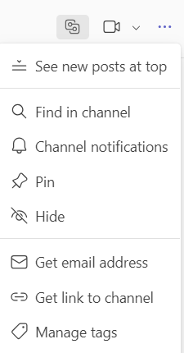
Teams
For each new project, create an internal separate Team channel and add all the relevant team members.
Create a separate, external Teams channel to also include customer’s team and relevant external stakeholders.
Upload any relevant documentation to the Teams channel to allow for review and collaboration.
Avoid sending document attachments – use links to the Teams documentation instead.
Easily pin other related files like OneNote, Visio or Mural as a new tab in the channel.
Use “posts” functionality for important updates.
Use “Get email address” option via vertical ellipsis “…” – when emailing to that address, the emails will automatically turn into a post on the Teams channel.

Slide 11
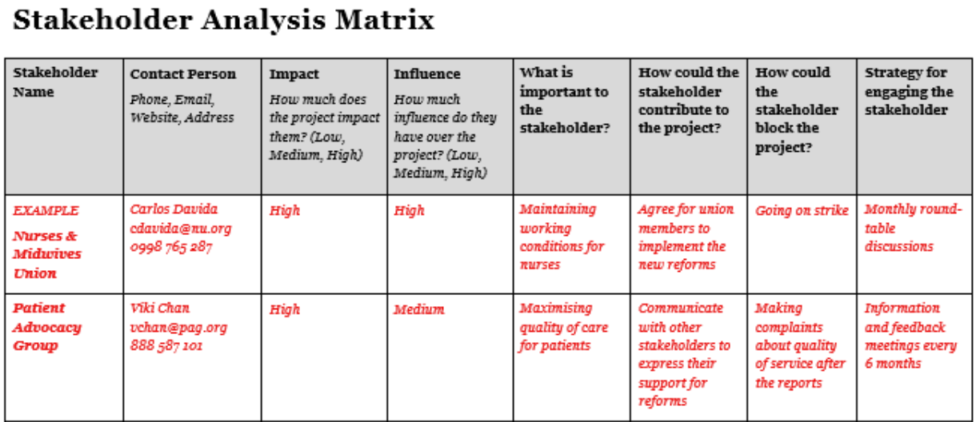
OneNote
OneNote is a versatile note-taking application that can be a valuable tool for documenting your Power Platform projects, capturing ideas, and organizing information. It offers rich formatting options, collaborative editing capabilities, and seamless integration with other Microsoft Office applications.
OneNote can be added as a tab to any Teams channel
Use it to track notes from meetings.
Thanks to the “to do” option, you can use it for checklists and actions to do and mark it “” once done.
Personal OneNote can be also handy for keeping useful links, formulas, and learning resources all in one place.
I also use it to track key information about customers and any relevant stakeholders.
When shared with the team, turn your stakeholder information into stakeholder analysis matrix as showed on the example.

Slide 12
Chrome Extensions

Slide 13
Chrome Extensions (1/2)
Name | Description | Link
Level up for Dynamics 365 /Power Apps | Quick navigation to open advanced find, solutions, etc. Unhide fields and logical names “God” mode & Impersonate Users’ support & troubleshooting …. and more! | https://chromewebstore.google.com/detail/level-up-for-dynamics-365/bjnkkhimoaclnddigpphpgkfgeggokam
Dynamics 365 Power Pane | Similar to Level Up Additionally “Form Editor” and “Entity Editor” | https://chromewebstore.google.com/detail/dynamics-365-power-pane/eadknamngiibbmjdfokmppfooolhdidc
Toolshed for Power Platform / Dynamics 365 | Execute basic natural language query Specific queries e.g. “create web resource in solution” (solution be specified) Also… “tell me a joke” query! | https://chromewebstore.google.com/detail/toolshed-for-power-platfo/ghiblnflpmebfpgbccbdhipgandmhkei
D365 SidePanel Dev Tools | Can be docked as a side panel Similar features to the other tools, but with some extras e.g. Plugin Trace Logs Explorer | https://chromewebstore.google.com/detail/d365-sidepanel-dev-tools/cbcpebonnklbnemkgkmofpkebonjifff
AutoReview for Power Automate | Code review & scoring Export variables, actions, and connections Create flow diagrams | https://chromewebstore.google.com/detail/autoreview-for-power-auto/laaendfpgmhjilhjkbebekgdgfjaajif
Plugin Code Generator D365 | Generate code snippets or templates for plugins Save as “cs” file | https://chromewebstore.google.com/detail/d365-plugin-code-generato/ldlbfikjagdgcoobnodifjjlhmijehhc
D365-UI-Test-Designer | Create and export test suites Import test suites Test execution | https://chromewebstore.google.com/detail/d365-ui-test-designer/lfcoehhlodiaehjepemaogbgadfoipog

Slide 14
Chrome Extensions (2/2)
Name | Description | Link
D365: Dynamics 365 & Power Platform updates | Extension to D365Hub blog Latest updates from various Blogs, YouTube channels, and Podcasts Set preferences across Azure, D365, Microsoft 365 and Power Platform | https://chromewebstore.google.com/detail/d365-dynamics-365-power-p/fogmingjemmagobaogmanbfeljbboehd
Fake Filler | Fills all inputs on a page with fake/dummy data Great for unit test Use for forms on Power Apps and Power Pages | https://chromewebstore.google.com/detail/fake-filler/bnjjngeaknajbdcgpfkgnonkmififhfo
Scribe: AI Documentation, SOPs & Screenshots | Generates steps with print screens Custom training materials and steps for users Copy and paste to the documentation | https://chromewebstore.google.com/detail/scribe-ai-documentation-s/okfkdaglfjjjfefdcppliegebpoegaii
(Click) Color Picker | Generates steps with print screens Custom training materials and steps for users Copy and paste to the documentation | https://chromewebstore.google.com/detail/color-picker/plkgncpmcodceeghncefaiohiekknelh https://chromewebstore.google.com/detail/click-color-picker/bfenhnialnnileognddgkbdgpknpfich
PrettifyMyWebApi for Microsoft Dataverse | Open any row in the Dataverse Web Api and quickly view or edit it Works even when fields are not available on any form Allows to quickly view and edit Power Automate Flow definitions | https://chromewebstore.google.com/detail/prettifymywebapi-for-micr/pcgbnpkpijlcjeleijaaahlonafdlfno
Power Apps Studio Tools | Tools for Power Apps Studio to enhance the developer experience Provides the ability to re-skin the Power Apps Studio formula bar in dark mode. Allows to test your app looks in greyscale, to check for potential accessibility issues. | https://chromewebstore.google.com/detail/power-apps-studio-tools/jlbmdajobkmdjgoijbcefiahfaaapfno
Power Automate Tools | It enables editing a Power Automate flow definition as JSON Supports workflow definition JSON schema validation Rich text manipulation features thanks to Monaco Editor (VS Code) Validate actions using "Flow Checker" | https://chromewebstore.google.com/detail/power-automate-tools/jccblbmcghkddifenlocnjfmeemjeacc

Slide 15
Developer Tools

Slide 16
XrmToolBox
Probably this one doesn’t need any intro, but still…
XrmToolBox is a Windows application that connects to Microsoft Dataverse.
It provides a collection of tools and utilities for D365 and Power Platform.
It offers a range of functionalities, including data manipulation, metadata browsing, and plugin development, to help you streamline your Power Platform development tasks.
https://www.xrmtoolbox.com
Great tools to use:
Iconator
Easy Translator
Mailbox Manager
Access Checker
FetchXML
Flow to Visio
and much more!

Slide 17
Developer Tools (1/3)
Name | Description | Link
Power Platform SDK | Power Platform SDK provides a set of libraries and tools that allow you to interact with Power Platform services programmatically. It offers APIs for data manipulation, authentication, and integration, enabling you to build custom solutions and extend the functionality of your Power Platform applications. It comes with comprehensive documentation and support. | https://learn.microsoft.com/en-us/power-apps/developer/data-platform/developer-tools
Plugin Registration | Plugin Registration is a tool provided by the Power Platform SDK that allows you to register and manage custom plugins for your Power Platform applications. It provides a user-friendly interface for deploying plugins, setting execution order, and troubleshooting plugin issues. | https://learn.microsoft.com/en-us/power-apps/developer/data-platform/register-plug-in
Configuration Migration Tool | The Configuration Migration Tool is a command-line utility that helps you migrate configuration data between Power Platform environments. It simplifies the process of moving customisations, settings, and data from one environment to another, ensuring consistency and reducing manual effort. It supports custom entities, attributes, and configurations. | https://learn.microsoft.com/en-us/power-platform/alm/configure-and-deploy-tools
PowerShell | PowerShell is a powerful tool for creating Power Platform solutions, especially when it comes to automation, administration, and deployment tasks. PowerShell offers modules specifically tailored for managing and automating tasks related to the Power Platform. With cmdlets (pronounced command-lets), developers can automate administrative tasks, manage environments, deploy solutions, and interact with various components of the Power Platform programmatically. It can be used to facilitate continuous integration and continuous deployment (CI/CD) pipelines for Power Platform solutions. PowerShell allows developers to retrieve data and generate reports from various components of the Power Platform, facilitating monitoring and performance analysis. | https://learn.microsoft.com/en-us/powershell/

Slide 18
Developer Tools (2/3)
Name | Description | Link
Visual Studio | Visual Studio IDE is a robust development environment with a powerful code editor, debugging tools, and integrated Git support. It provides a seamless development experience for building Power Platform solutions. Whether you're developing Power Apps, Power Automate flows, or custom connectors, Visual Studio offers unmatched flexibility and productivity. Visual Studio Code is a lightweight but powerful source code editor. With the addition of the Power Platform extensions, it provides a customizable and efficient development environment. | https://visualstudio.microsoft.com
Power Platform Tool for Visual Studio | Extension that brings Power Platform development capabilities directly into the Visual Studio environment. It offers project templates, code snippets, and debugging tools to streamline the development of Power Platform solutions within the familiar Visual Studio interface. | https://marketplace.visualstudio.com/items?itemName=microsoft-IsvExpTools.PowerPlatformToolsVS2022#:~:text=Power%20Platform%20Tools%20for%20Visual,endpoints%2C%20webhooks%2C%20and%20more
Dataverse DevTools for VS Code | Extension that enhances the development experience for Power Platform solutions within Visual Studio Code. It provides IntelliSense, code snippets, and debugging capabilities tailored for Dataverse development, making it easier to write, test, and debug your code. | https://marketplace.visualstudio.com/items?itemName=danish-naglekar.dataverse-devtools#:~:text=This%20repo%20is%20an%20open,VS%20Code%20and%20much%20more
Power Platform CLI | Power Platform Command-Line Interface (CLI) is one-stop developer CLI that empowers developers and ISVs to perform various operations in Power Platform. They include environment lifecycle, authentication, Dataverse environments, solution packages, Power Pages, code components and more. | https://learn.microsoft.com/en-us/power-platform/developer/cli/introduction?tabs=windows

Slide 19
Developer Tools (3/3)
Name | Description | Link
Notepad++ | Notepad++ is a lightweight text editor with advanced features that can be useful for editing code, scripts, and configuration files for Power Platform solutions. It offers syntax highlighting, code folding, and search/replace capabilities, making it easier to write and maintain code. For me, as a functional consultant is easier to use compared to e.g. Visual Studio as I have only very basic requirements when it comes to writing/viewing code. | https://notepad-plus-plus.org
Postman | Postman is a popular API testing tool that can help you design, test, and debug APIs for your Power Platform applications. It offers a user-friendly interface for sending HTTP requests, inspecting responses, and automating API tests, making it easier to ensure API reliability and performance. It came handy for me when I worked with Power Automate and the HTTP requests. | https://www.postman.com
Fiddler | Fiddler is a powerful web debugging proxy tool that can help you monitor, inspect, and manipulate HTTP/HTTPS traffic between your Power Platform applications and external services. It offers advanced debugging and testing capabilities, making it easier to diagnose issues and optimise performance. | https://www.telerik.com/fiddler

Slide 20
Developer Tools - Testing
Name | Description | Link
Mockaroo | Mockaroo is a data mocking tool that allows you to generate realistic test data for your Power Platform applications. It offers a simple interface for creating custom data sets with various data types, formats, and constraints, making it easier to conduct thorough testing and validation. It integrates with Power Platform and other systems. | https://www.mockaroo.com
RNDGen | RNDGen Random Data Generator is a free user-friendly tool for generate test data. The data creator uses an existing data model and customizes it to create a mock data table structure. It allows you to easily create dummy data for tests that are representative of real-world scenarios, with the ability to select from a wide range of fake data details fields including name, email, location, address, zip and vin codes and many others. You can quickly generate thousands of fake data rows in different formats, including CSV, SQL, JSON, XML, or Excel. Great tool for generating Excel import files to prep a demo. | https://www.rndgen.com/data-generator
Selenium | For testing Power Apps portals or web-based components of your solution, Selenium can automate browser interactions and help validate the functionality and user experience. | https://www.selenium.dev
Azure Test Plans | Azure Test Plans provides rich and powerful tools everyone in the team can use to drive quality and collaboration throughout the development process. The easy-to-use, browser-based test management solution provides all the capabilities required for planned manual testing, user acceptance testing, exploratory testing, and gathering feedback from stakeholders. | https://learn.microsoft.com/en-us/previous-versions/azure/devops/test/overview?view=tfs-2017

Slide 21
Developer Tools – Data
Name | Description | Link
SQL Server Management Studio (SSMS) | SQL Server Management Studio (SSMS) is an integrated environment for managing any SQL infrastructure, from SQL Server to Azure SQL Database. It provides tools to configure, monitor, and administer instances of SQL Server and databases. Use SSMS to deploy, monitor, and upgrade the data-tier components used by your applications and build queries and scripts. It also used to query, design, and manage your databases and data warehouses, wherever they are - on your local computer or in the cloud. The latest version also auto-installs Azure Data Studio. | https://learn.microsoft.com/en-us/sql/ssms/download-sql-server-management-studio-ssms?view=sql-server-ver16
KingswaySoft | KingswaySoft offers a suite of data integration tools that can help you streamline data migration, synchronization, and transformation tasks for Power Platform solutions. It provides a visual interface for designing data flows and supports a wide range of data sources and destinations. Alternative for bigger and more complex data migration where the standard Power Platform data import tool is not inadequate. | https://www.kingswaysoft.com/
Power BI Desktop | Power BI Desktop is used as a tool for generating Power BI reports and dashboards. It allows you to visually explore your data through a free-form drag-and-drop canvas, a broad range of modern data visualisations, and an easy-to-use report authoring experience. | https://powerbi.microsoft.com/en-us/downloads/ https://www.microsoft.com/en-us/download/details.aspx?id=58494

Slide 22


Blog
https://www.ppcookbook.com
LinkedIn
https://www.linkedin.com/in/anna-black-ppcookbook
YouTube:
https://www.youtube.com/channel/UCbgY5HQUl4L5XaKXe2mu5wA
GitHub
https://github.com/aniablack

